Slide 1


Big Mountain Resort Profit Recovery
Dylan Neal
Springboard Data Science Career Track

Slide 2
Problem Identification
Big Mountain Resort has recently installed an additional chair lift to help increase distribution of visitors across the mountain. The chair increases operating costs by $1.54 M. The current profit margin is 9.2%, and investors would like to keep it there.

Slide 3
Recommendation and Key Findings
The price of adult weekend tickets should be increased from $81.00 to $93.20
Assuming no drop in weekend attendance, this would represent an approximate 15% increase in revenue from adult weekend tickets.

Slide 4
Modeling Results and Analysis
A regression model was implemented in order to predict what the appropriate price of adult weekend tickets should be at Big Mountain Resort
The data was scrubbed before model execution to fill null values, remove duplicates, and perform minimal outlier removal.

Slide 5
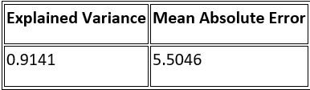
Modeling Results and Analysis
Explained Variance and Mean Absolute Error for the model are displayed below in table 1
Table 1
An explained variance score of 1 is optimal
Mean absolute error should be as low as possible

Slide 6
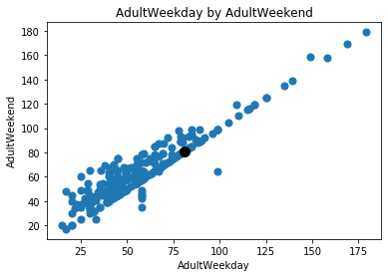
Modeling Results and Analysis
Support for increasing adult weekend ticket price can be shown in figure 1. Figure 1 is a scatter plot of adult weekday ticket prices and adult weekend ticket prices for other ski resorts. For adult weekday prices <$100, it is common to have weekend prices that are $20 - $40 higher.
Big Mountain Resort’s Adult Weekday Ticket Price is $81.00
Figure 1

Slide 7
Summary and Conclusion
A 15% increase in revenue from adult weekend ticket prices could protect the current 9.2% profit margin. A few considerations should be taken:
Increasing ticket prices could result in fewer ticket sales
Without additional data (projected weekend ticket sales, total projected profits) it is difficult to tell if the increased weekend ticket revenue will be sufficient

